Slide 1
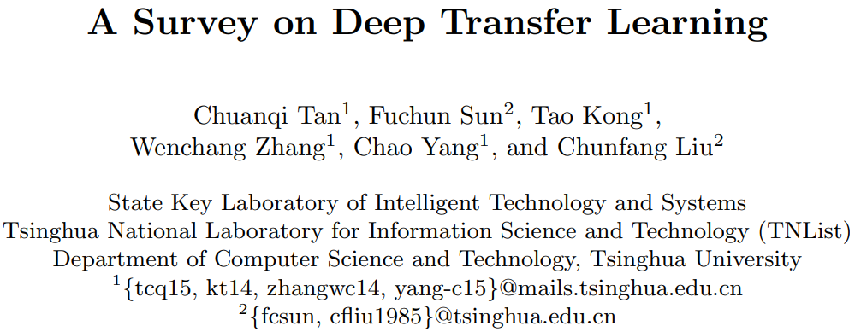
Literature Report
Zihao Li, 2020.08.21

Slide 2
Why Transfer Learning
In some domains, like bioinformatics and robotics, it is very difficult to construct a large-scale well-annotated dataset due to the expense of data acquisition and costly annotation, which limits its development;
Transfer learning relaxes the hypothesis that the training data must be independent and identically distributed (i.i.d.) with the test data, which motivates us to use transfer learning to solve the problem of insufficient training data.

Slide 3
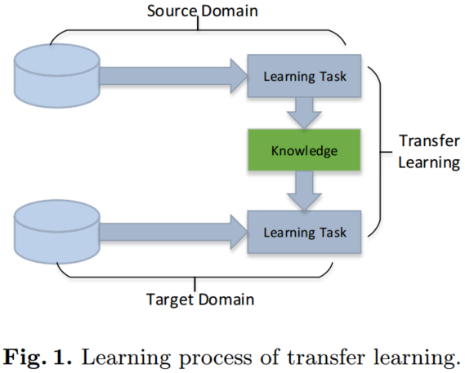
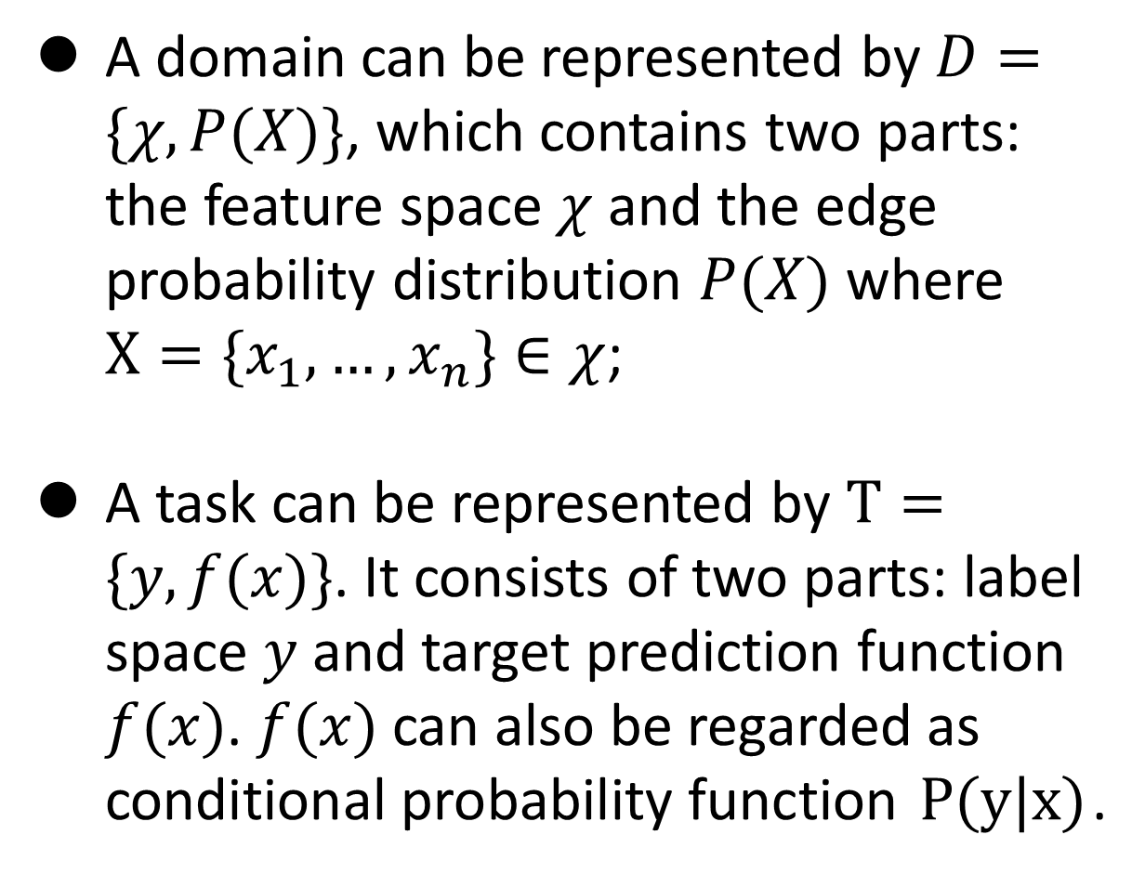
Definitions
A domain can be represented by $D=\{χ,P(X)\}$, which contains two parts: the feature space $χ$ and the edge probability distribution $P(X)$ where $X=\{x_{1},…,x_{n}\}∈χ$;
A task can be represented by $Τ=\{y,f(x)\}$. It consists of two parts: label space $y$ and target prediction function $f(x)$. $f(x)$ can also be regarded as conditional probability function $P(y|x)$.

Slide 4
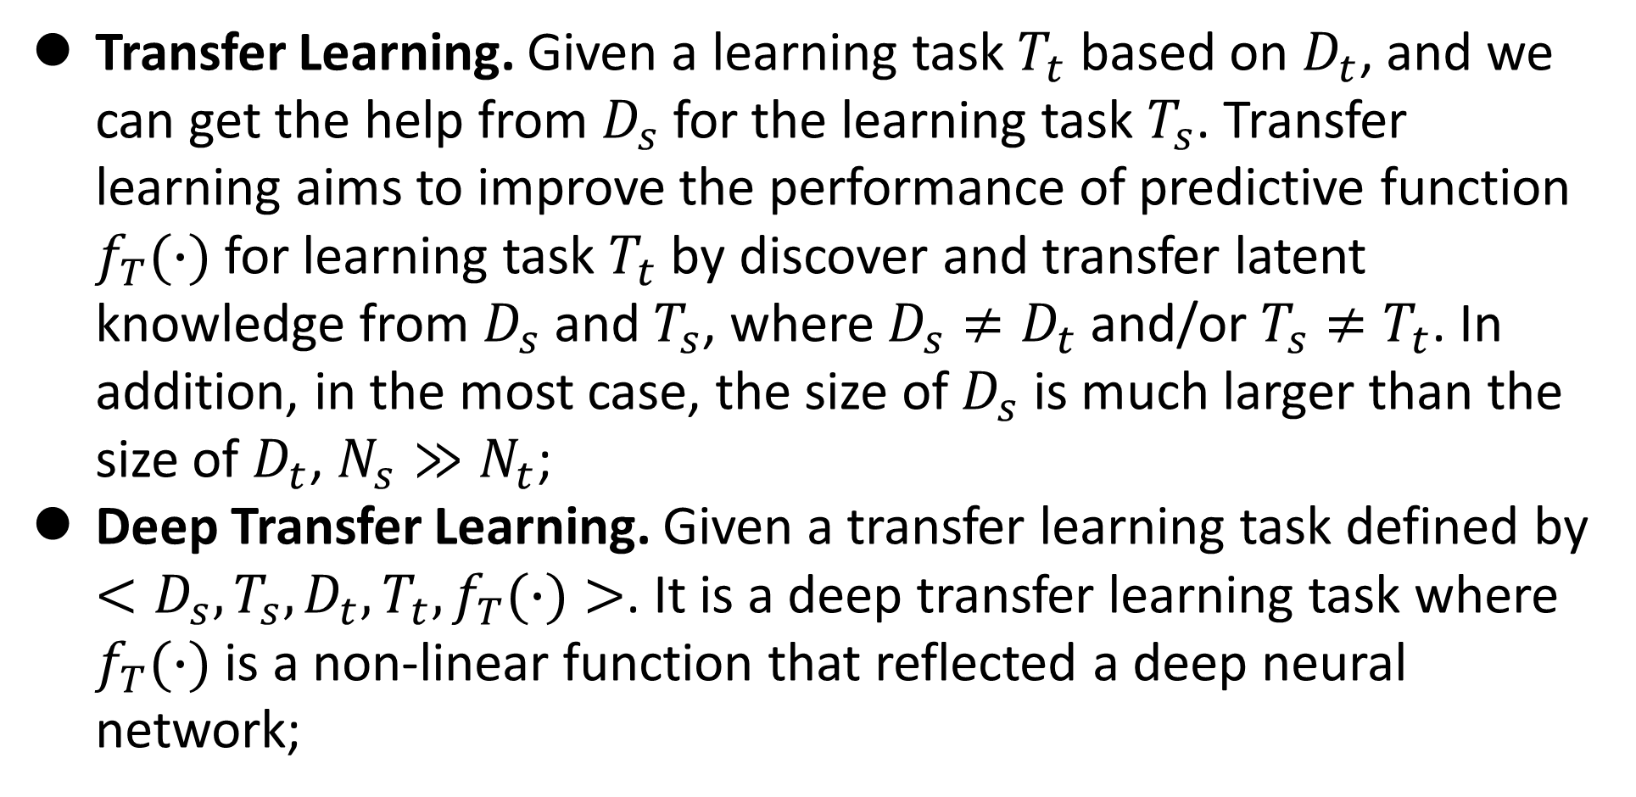
Definitions
Transfer Learning. Given a learning task $T_{t}$ based on $D_{t}$, and we can get the help from $D_{s}$ for the learning task $T_{s}$. Transfer learning aims to improve the performance of predictive function $f_{T}(∙)$ for learning task $T_{t}$ by discover and transfer latent knowledge from $D_{s}$ and $T_{s}$, where $D_{s}≠D_{t}$ and/or $T_{s}≠T_{t}$. In addition, in the most case, the size of $D_{s}$ is much larger than the size of $D_{t}$, $N_{s}≫N_{t}$;
Deep Transfer Learning. Given a transfer learning task defined by $<D_{s},T_{s},D_{t},T_{t},f_{T}(∙)>$. It is a deep transfer learning task where $f_{T}(∙)$ is a non-linear function that reflected a deep neural network;

Slide 5
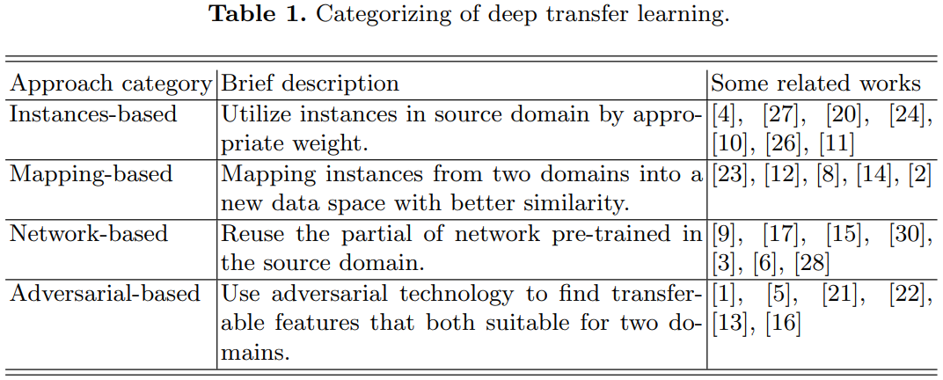
Categorizes

Slide 6
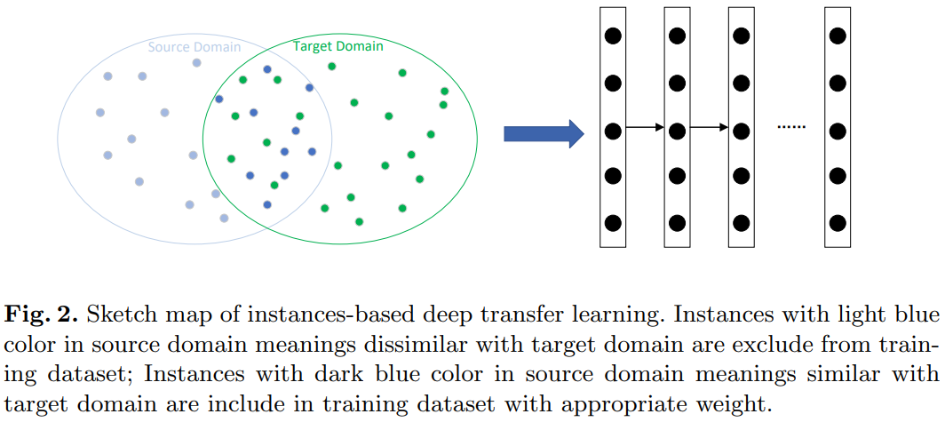
Instances-based deep transfer learning
Although there are different between two domains, partial instances in the source domain can be utilized by the target domain with appropriate weights.

Slide 7
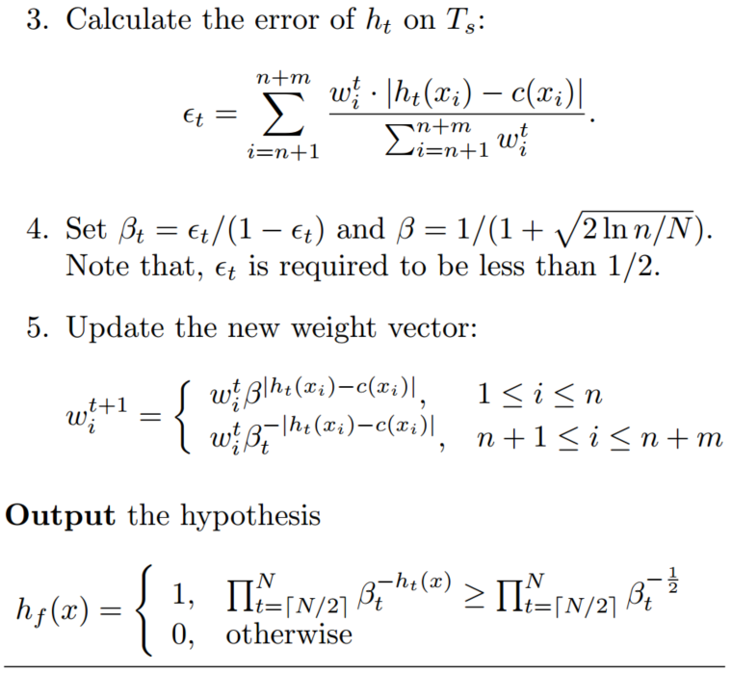
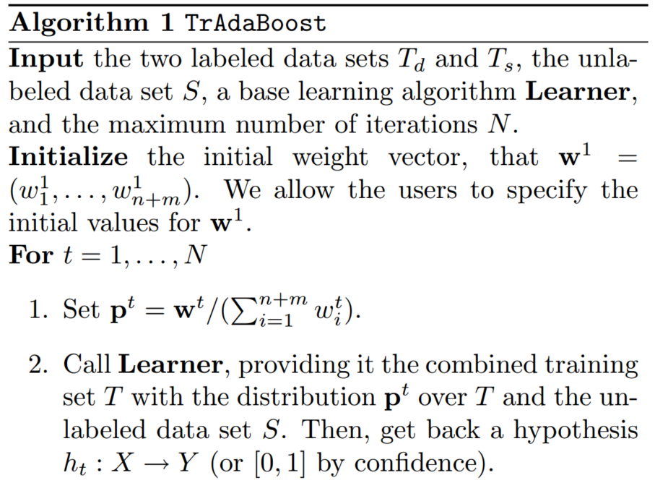
TrAdaBoost

Slide 8
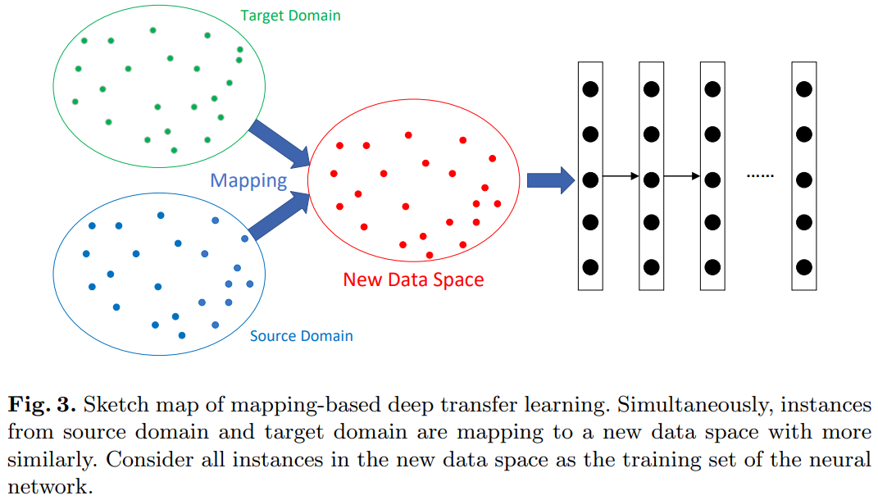
Mapping-based deep transfer learning
Although there are different between two origin domains, they can be more similarly in an elaborate new data space.

Slide 9
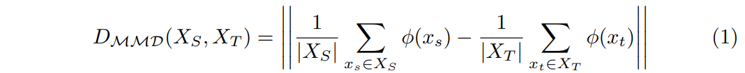
Mapping-based deep transfer learning
A natural idea is extend the TCA (Transfer component analysis) method to deep neural network extend MMD to comparing distributions in a deep neural network, by introduces an adaptation layer and an additional domain confusion loss to learn a representation that is both semantically meaningful and domain invariant. The MMD distance used in this work is defined as
The loss function is defined as

Slide 10
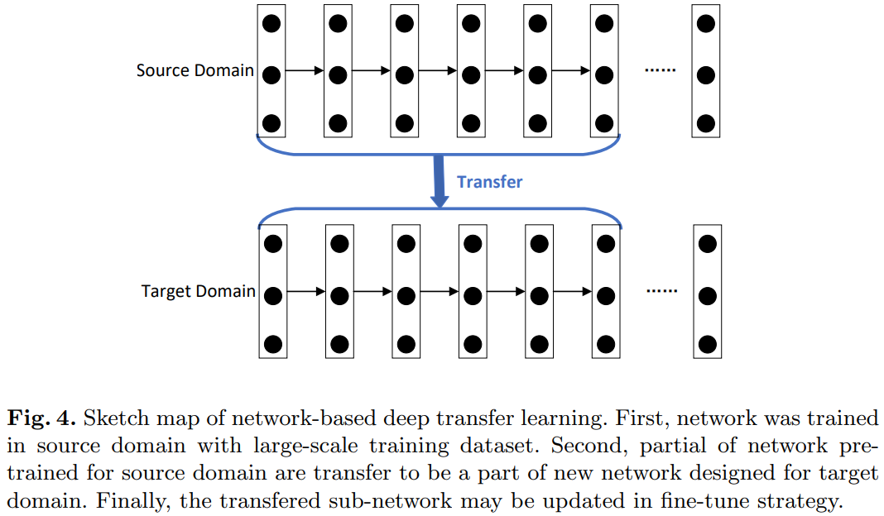
Network-based deep transfer learning
Neural network is similar to the processing mechanism of the human brain, and it is an iterative and continuous abstraction process. The front-layers of the network can be treated as a feature extractor, and the extracted features are versatile.

Slide 11
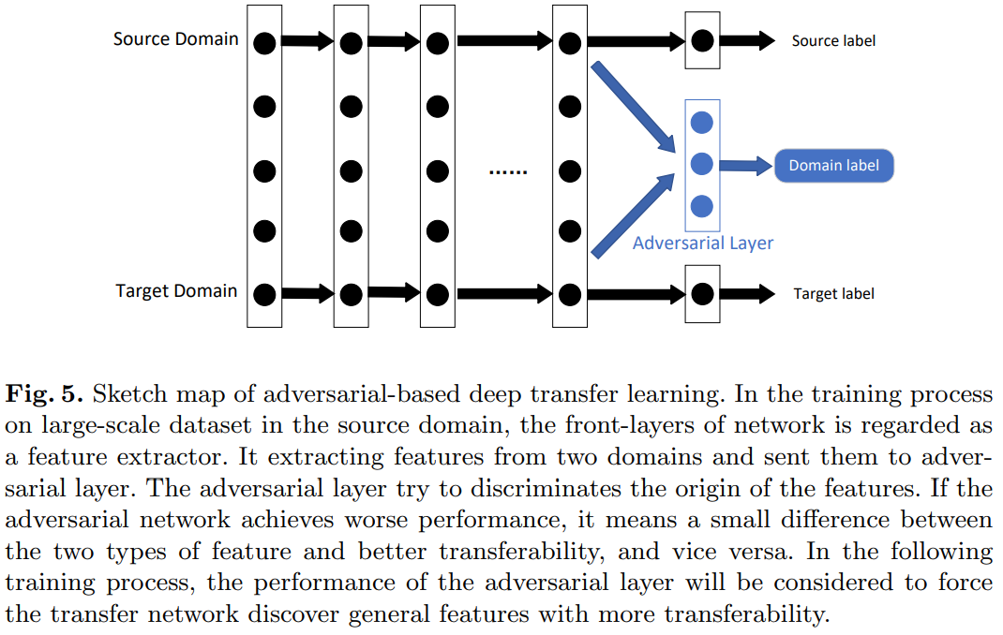
Adversarial-based deep transfer learning
For effective transfer, good representation should be discriminative for the main learning task and indiscriminate between the source domain and target domain.

Slide 12
Summary & Conclusion
Deep transfer learning is classified into four categories: instances-based deep transfer learning, mapping-based transfer learning, network-based deep transfer learning, and adversarial-based deep transfer learning;
In most practical applications, the above multiple technologies are often used in combination to achieve better results;
Network-based deep transfer learning are widely used, especially for pre-training and fine tuning.

Slide 13
References
[1] Tan C, Sun F, Kong T, et al. A survey on deep transfer learning[C]//International conference on artificial neural networks. Springer, Cham, 2018: 270-279.
[2] Dai, W., Yang, Q., Xue, G.R., Yu, Y.: Boosting for transfer learning. In: Proceedings of the 24th international conference on Machine learning. pp. 193{200. ACM (2007).
[3] Pan, S.J., Tsang, I.W., Kwok, J.T., Yang, Q.: Domain adaptation via transfer component analysis. IEEE Transactions on Neural Networks 22(2), 199{210 (2011).
[4] Zhang, J., Li, W., Ogunbona, P.: Joint geometrical and statistical alignment for visual domain adaptation. In: CVPR (2017).
[5] Tzeng, E., Hoffman, J., Zhang, N., Saenko, K., Darrell, T.: Deep domain confusion: Maximizing for domain invariance. arXiv preprint arXiv:1412.3474 (2014).
[6] Ajakan, H., Germain, P., Larochelle, H., Laviolette, F., Marchand, M.: Domainadversarial neural networks. arXiv preprint arXiv:1412.4446 (2014);

Slide 14
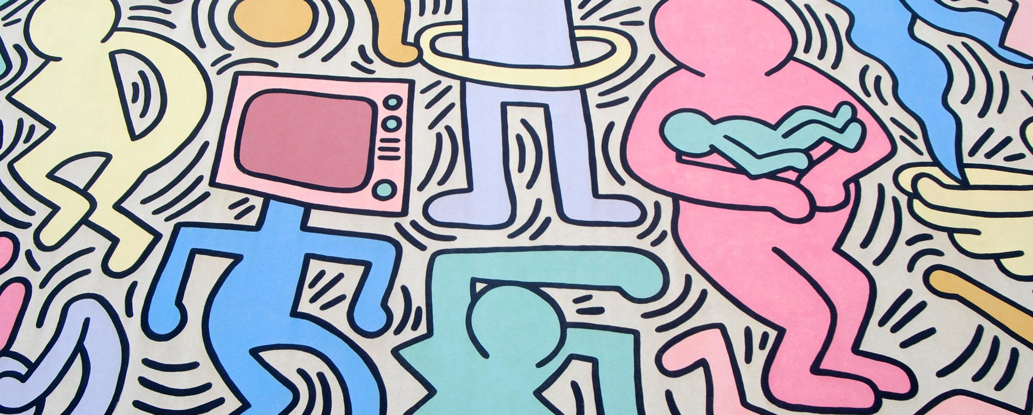
Q&A
Reference
Thanks

